Slide 1
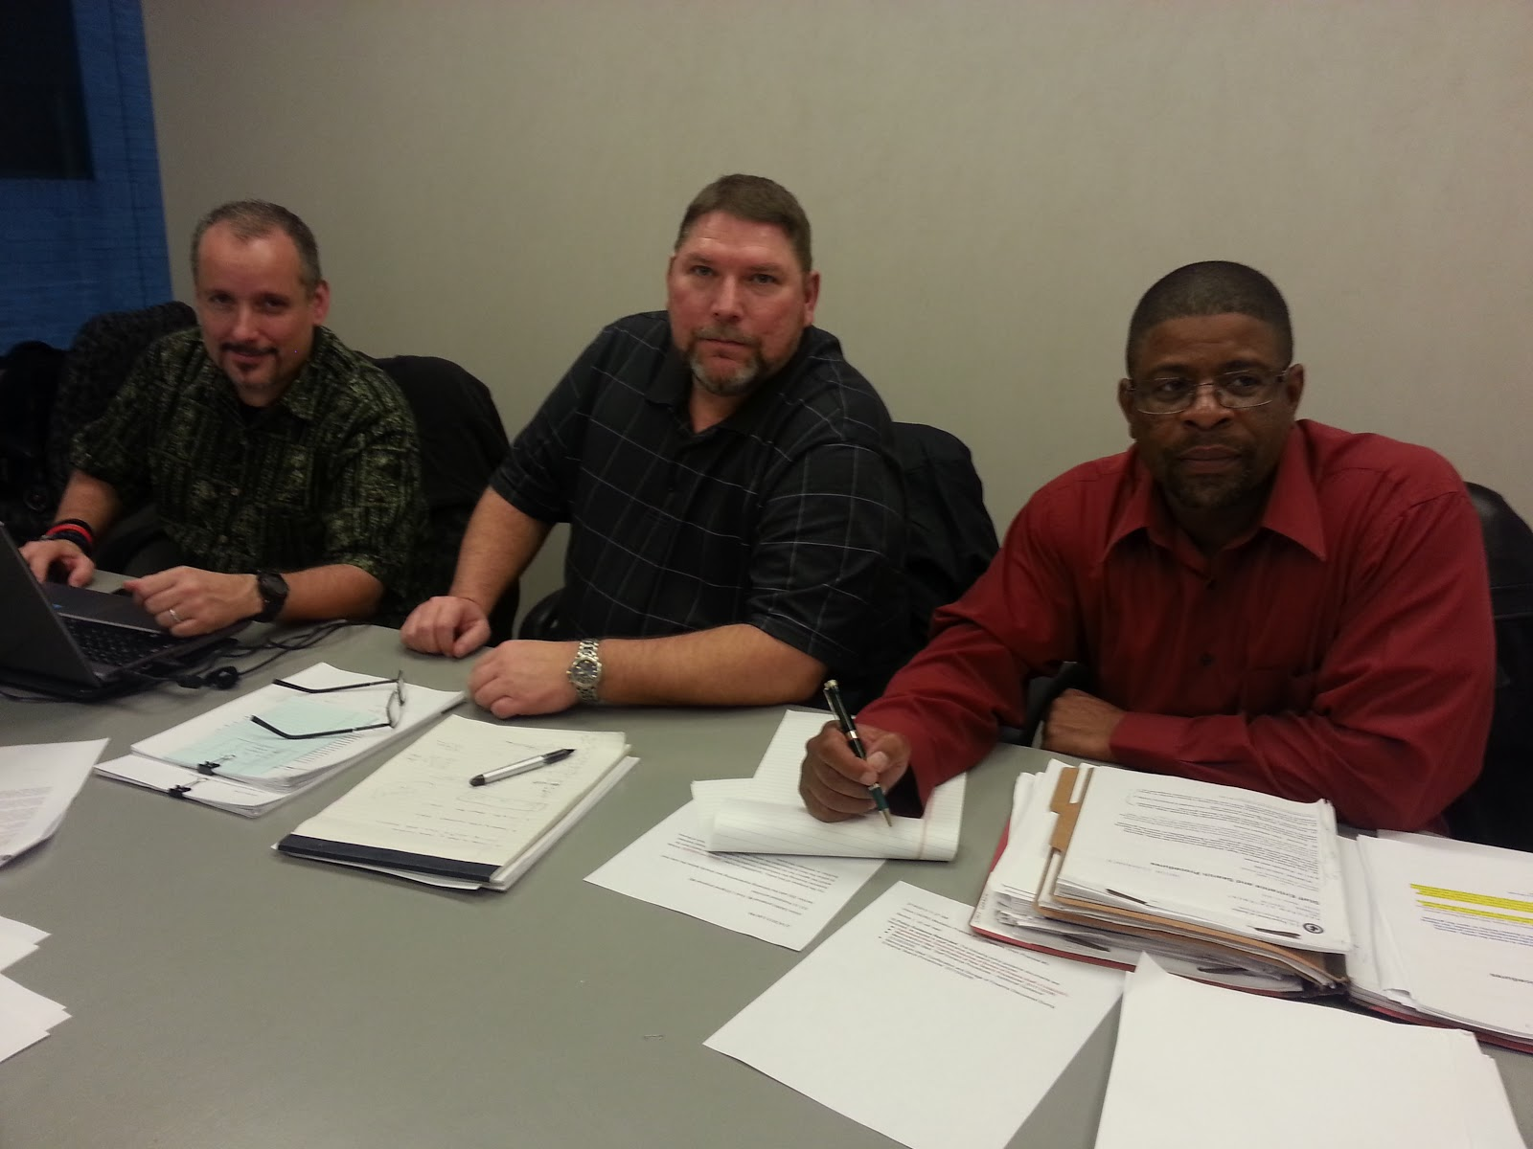
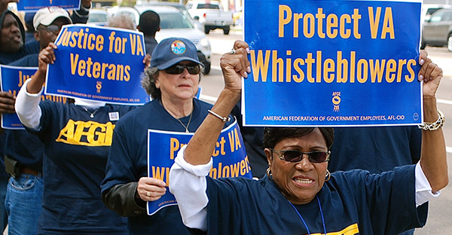
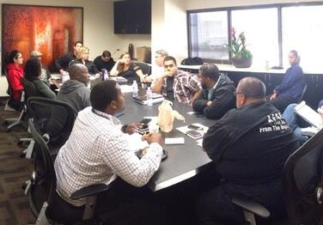
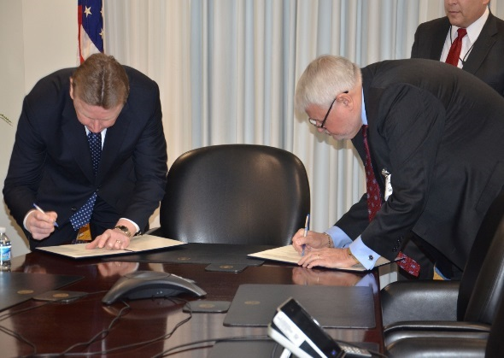
Collective Bargaining II: Negotiation Skills
AMERICAN FEDERATION OF GOVERNMENT EMPLOYEES, AFL-CIO
Notes:
Suggested Language:
Hello my name is___ I am the ____ at___.
Welcome to AFGE’s Introduction to Collective Bargaining II class on Negotiation Skills. This training has been designed to provide you with the skills and knowledge to negotiate effectively to improve the conditions of employment for the federal employees you represent.
This training will be a hands-on workshop that will use realistic scenarios and cases studies for you to engage in and demonstrate effective negotiation skills and techniques.

Slide 2
Course Objective
Demonstrate how to effectively use Big Enough to Win Bargaining techniques and strategies to turn planning, process, and people into power at the bargaining table.
AMERICAN FEDERATION OF GOVERNMENT EMPLOYEES, AFL-CIO
Notes:
Suggested Language: Here is the primary objective for this course. To achieve this objective, you will participate in various learning activities and realistic case study scenarios that will provide you the opportunity to learn and demonstrate BETW bargaining techniques and strategies.
Suggested Language:
The purpose of this course is to give you a hands-on opportunity to use critical negotiation skills and techniques that you need to know as you start or continue your journey as a union negotiator within AFGE. As we will discuss in this course, there are a lot of resources out there, particularly on the wonderful world-wide web, for you to access. What is important is that you keep yourself educated and in tune in your role as a Union Officer.

Slide 3
Course Overview
Course Structure
Materials/Resources
Assignments
AMERICAN FEDERATION OF GOVERNMENT EMPLOYEES, AFL-CIO
Notes:
Suggested Language:
Structure:
In order to achieve this objective we will be in this learning community together for three days. This course is structured as an intensive hands-on workshop that will focus on negotiation strategies and techniques using a realistic scenario involving telework and cybersecurity. You will be assigned to a team that will serve as one of five Locals in a bargaining Council. In this capacity, you will serve on the bargaining team of your Local and your Council. Each day, you will participate and observe in negotiations with other class participants and the instructor. To help you prepare for these negotiations, you will be provided time and guidance from the instructor in advance of each session. To gain the most out of this workshop, please take the time to fully review all of the information related to the bargaining scenarios.
Course Materials/Resources:
1. Walk participants through the materials that they would need for the session which is primarily the participant workbook, a writing utensil (for in person trainings), and any handouts that may be specific to your Local.
2. Briefly walk through the contents of the Participant Guide, pointing out the major sections, and explaining how the guide will be used.
Norms/Expectations
Tell participants that in order to make this course successful, we need basic norms. As What ground rules should we establish?
Solicit norms (ground rules) from participants and write them on Flip Chart Paper to remain visible throughout the session.

Slide 4
Housekeeping
Breaks and lunch
Location of bathrooms and emergency exits
Ground Rules
Participate and Share | Parking Lot
Mutual Respect | Honor Time
AMERICAN FEDERATION OF GOVERNMENT EMPLOYEES, AFL-CIO
Notes:
Suggested Language: Here is the primary objective for this course. To achieve this objective, you will participate in various learning activities and realistic case study scenarios that will provide you the opportunity to learn and demonstrate BETW bargaining techniques and strategies.
Suggested Language:
The purpose of this course is to give you a hands-on opportunity to use critical negotiation skills and techniques that you need to know as you start or continue your journey as a union negotiator within AFGE. As we will discuss in this course, there are a lot of resources out there, particularly on the wonderful world-wide web, for you to access. What is important is that you keep yourself educated and in tune in your role as a Union Officer.

Slide 5
Introductions
Name
Current Position
Local/Agency/Council
Experience in Collective Bargaining
Burning Question
AMERICAN FEDERATION OF GOVERNMENT EMPLOYEES, AFL-CIO
Notes:
Suggested Language: Here is the primary objective for this course. To achieve this objective, you will participate in various learning activities and realistic case study scenarios that will provide you the opportunity to learn and demonstrate BETW bargaining techniques and strategies.
Suggested Language:
The purpose of this course is to give you a hands-on opportunity to use critical negotiation skills and techniques that you need to know as you start or continue your journey as a union negotiator within AFGE. As we will discuss in this course, there are a lot of resources out there, particularly on the wonderful world-wide web, for you to access. What is important is that you keep yourself educated and in tune in your role as a Union Officer.

Slide 6
Module 1: Introduction to Strategic Bargaining
AMERICAN FEDERATION OF GOVERNMENT EMPLOYEES, AFL-CIO

Slide 7
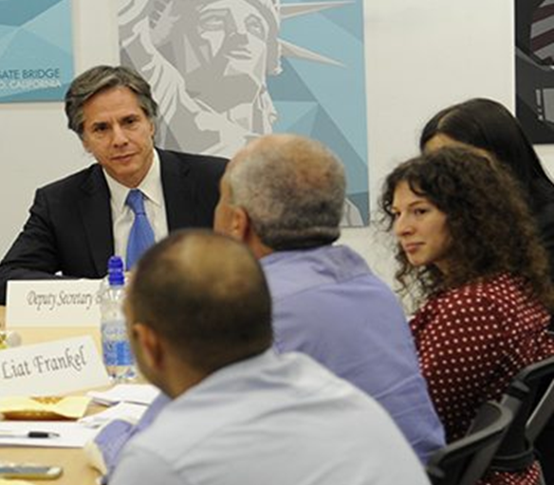
Definition of Negotiation
Negotiation is a process in which people work together to come to an agreement about one or more issues in dispute.
Negotiation between the Union and Management is referred to as collective bargaining.
Notes:
For this course, the terms negotiation and bargaining are synonymous

Slide 8
Elements of a Dispute
Interests: Needs, desires, concerns underlying a position.
Rights: Independent standards (CBA, law, past precedent, etc.) that establish precedent, fairness, etc.
Power: Capacity to force a position on another party. Can be a threat and/or action.
Interests
Power
DISPUTE
Rights

Slide 9
Factors that affect Negotiation
ISSUES
CONTEXT
PARTIES
POSITION
Issues: What is the topic or problem in dispute? Is it simple or complex? How important is it to each party?
Parties: What is the relationship? Trust level? Information sharing? Is power equal or unbalanced?
Context: What influence/support exits in the environment away from the table?
Position: One party’s solution to an issue. What does each side see as the resolution?

Slide 10
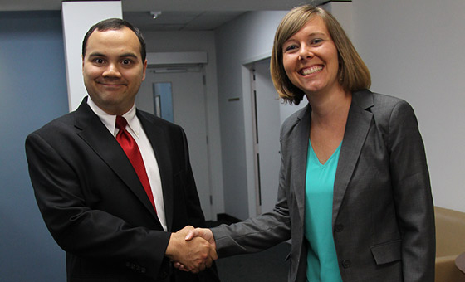
How Do You Measure Success in Negotiations?
Cost: How much time, energy, money and/or other resources are spent on resolving the dispute?
Outcome: How satisfied are the parties with the outcome of the negotiations?
Relationship: What is the effect of the negotiations on the relationship over the long term?

Slide 11
What is Strategic Bargaining?
Strategic bargaining is a process which can be adjusted to fit the experience level of the different negotiation team members.
It builds upon other disciplines and doctrines used by organized labor to influence a successful outcome for the bargaining unit employees.

Slide 12
Strategic Bargaining
Strategic Bargaining embraces and capitalizes on the principles of AFGE’s “Big Enough to Win” strategy.
Building on the Power of “the Union”
Energizing New Leaders
Energizing and Activating Current Members
Energizing and Activating Potential Members

Slide 13
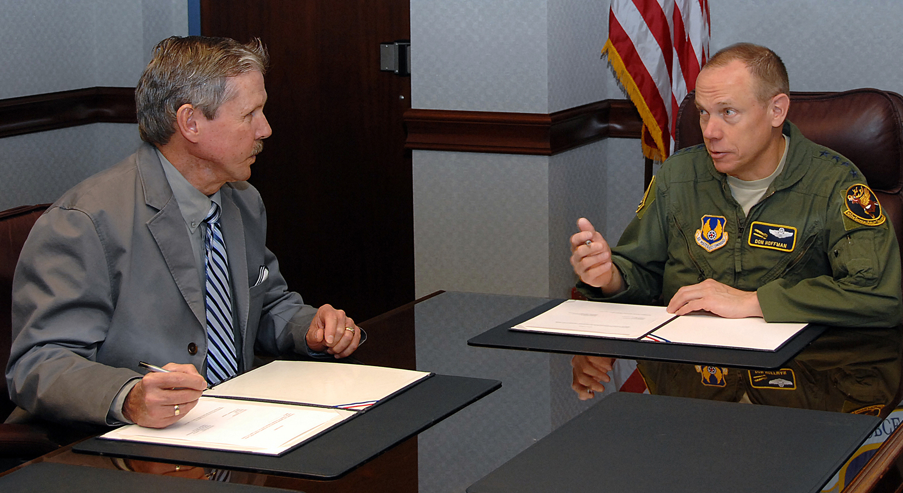
Strategic Bargaining
A strategic bargaining strategy can be applied to both term and mid-term negotiations.
Systems and structures developed for a strategic bargaining strategy can also be deployed to use in legislative grassroots mobilization efforts.
And it encourages activism and involvement by members.

Slide 14
Strategic vs. Reactive Bargaining
Reactive bargaining makes it difficult to establish bargaining support structures.
Efforts are rushed.
Research and outreach for information is limited.
Management often dictates or controls when and how bargaining is done.

Slide 15
Service Model vs. Organizing Model
AMERICAN FEDERATION OF GOVERNMENT EMPLOYEES, AFL-CIO
Notes:
Suggested Language:
As a union that represents Federal and Local Government workers, there are a certain set of Federal laws that directly relate to how we operate and the work that we do. In this next section, we will talk through these laws to start to get a better understanding of those laws.
Why do you think we spend so much time on legal stuff in our trainings?
----The more knowledge you have on the law, the more empowered you become. When it comes to the laws that guide the work you all do as union leaders… knowledge truly is power…
The laws we will review today pertains to the rights our membership have, the relationship between union officials and management and the agency. These laws pertain to how you run your Local…. So knowing the law for yourself

Slide 16
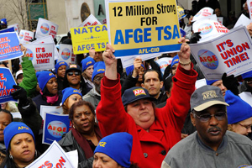
Effective Locals: Service vs. Organizing Model
Unions can operate in one of two ways:
Service Model
or
Organizing Model

Slide 17
The Service Model
A Service Model Union is a fee-for-service organization. The members pay fees (dues) for the union’s services, such as bargaining and grievance representation.
The Union is little more than a service provider.
The Union is seen as a third party entity.
The Service Model does not build ownership or involve the rank and file membership in Union activities, such as collective bargaining.
Notes:
The Union is little more than a service provider: you pay Comcast for your cable, Geico for your insurance, and AFGE for your Union representation.
The Union is conceived of as a third party representing the workers, not the workers themselves. Elected officers are expected to know and perform all the work.
It does not build ownership, understanding, or change the workplace dynamic for the rank-and-file member.
Even worse, it is simply less effective. The power of a Union rests with the members, and the ability to mobilize the workforce. The Service Model undoes that.

Slide 18
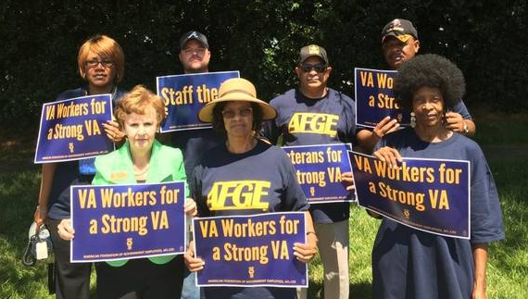
The Organizing Model
An Organizing Model Union is run by the members around issues and activities that matter to them.
The Union not seen as a third party.
The Union is recognized as an organization of employees working together to help each other.
Power, mobilization, and issue development comes from the members.
Notes:
Union is not seen as a third party that is paid to represent the needs of the members, it is understood to be the members themselves.
There may be staff who work on behalf of the members, but the power, mobilization and issue development all come from the rank and file employees. Organizing Model Unions are based upon the idea of the workers themselves taking ownership of the Union, and the workplace, and changing the dynamic between them and employer- it is about empowerment.
Employees take ownership of the Union, and the workplace.

Slide 19
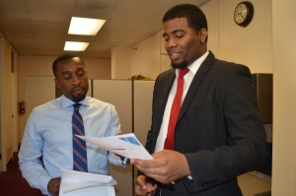
Bargaining: Organizing vs. Servicing Model
Collective bargaining is more effective with Organizing Model Unions:
Collective bargaining involves power and leverage.
The main resource for Unions is their membership.
Members may have connections with the community, managers, and others who can influence the Agency.
A bargaining team must communicate with membership to identify the most important issues.
Notes:
Members may have connections with the community, managers, and others who can influence the Agency.

Slide 20
Strategic Bargaining Assessment
AMERICAN FEDERATION OF GOVERNMENT EMPLOYEES, AFL-CIO

Slide 21
START WITH A BASIC ASSESSMENT
How is bargaining viewed?
What is your experience level?
What resources do we have to work with?
What do we hope to achieve?
Who are we bargaining with?

Slide 22
ATTITUDE TOWARDS BARGAINING
How do you view bargaining?

Slide 23
ATTITUDE TOWARDS BARGAINING
Every Negotiating Team must bargain with an eye towards:
Building a stronger contract
Building a relationship with management that will better serve the members
Building the strength of unit

Slide 24
Changing how Collective Bargaining is viewed
By the Union
We don’t bargain in a bubble
We bargain at the table - we win away from the table
By the Employees
This is our process
This is a chance to be engaged
This is a chance to have a voice
By the Agency
This is a collaborative process, we need mutual agreement
We are partners in this process, we must learn to work together

Slide 25
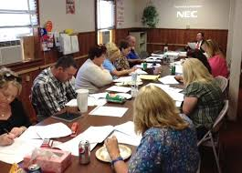
Experience Level and Training
What kind of bargaining experience exists on the team?
Where do our strengths lie?
What other skills/experience would be useful when bargaining?
Do we need any specific type of training?

Slide 26
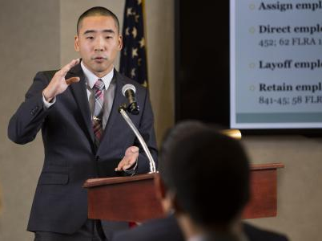
Experience Level and Training
What kind of bargaining experience exists on the Agency team?
How have they bargained in the past?
What relationships exist within the Agency that can assist the Union?

Slide 27
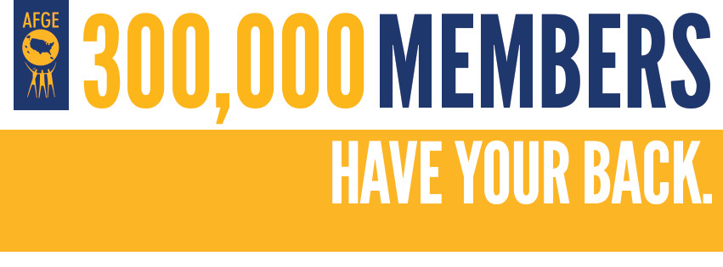
Resources
Membership
District
Other Locals
Council
National
Outside groups or coalitions

Slide 28
Strategic Bargaining Process

Slide 29
Bargaining Preparation
Identify Goals
Bargaining team training and assignments
Communications and Community Outreach
Organizing
Legislative
Research
Notes and Records
Pre-Bargaining Prep and Ground Rules
Research
Contract Proposal Preparation
Negotiations

Slide 30
Strategic Bargaining Process Goals and Objectives

Slide 31
Goals and Objectives
To have a plan, we need to know what we want and what we hope to achieve. What are our goals to improve:
Contract language
Labor management relationship
Internal communications
Community and legislative outreach
Membership growth/organizing goals in campaign

Slide 32
Goals vs. Objectives
Goals are broad
Goals are general intentions
Goals are intangible
Goals are abstract
Objectives are narrow
Objectives are precise
Objectives are tangible
Objectives are concrete
Notes:
Goals can't be validated; objectives can be validated.

Slide 33
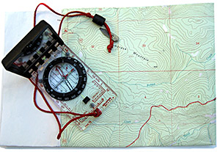
How are Goals and Objectives Important?
If we find ourselves moving away from the plan, we need to ask if the action helps us achieve a goal.
Is achieving the goal tied to a specific task or action?
If so, what action?
Are there multiple tasks or actions tied to the goal?

Slide 34
Example: Better Contract Language
In order to obtain this objective, there are a series of tasks to be completed:
Research
Bargaining Survey
Information Request
Communicate and Mobilize
Notes:
Research occurs at multiple points in the bargaining process (prior to drafting proposals, and reviewing and drafting counterproposals

Slide 35
Strategic Bargaining Process Bargaining Team: Working Groups

Slide 36
Communications Working Group
Nominate/appoint working group
Train working group
Develop working group strategic plan for the following tasks:
Issue identification/topics
Schedule and distribute bargaining updates
Development newsletters, press releases, petitions
Develop and coordinate Op/Ed pieces and media outreach
Develop coordination with groups and organizations with shared interests

Slide 37
Organizing Working Group
Nominate/appoint working group
Train working group
Develop working group strategic plan for the following tasks:
Development of issue organizing message
Workplace mapping
Scheduled organizing events to coincide with bargaining dates
Updated local official contact in AFGE MyLocal
Draft phone-tree for organizing committee work
Develop bargaining specific organizing literature

Slide 38
Legislative Working Group
Nominate/appoint working group
Train working group
Develop working group strategic plan for the following tasks:
Coordinate support for issue-based lunch and learns
PAC events
Outreach to nearby Locals, Central Labor Councils, State Federations, customer advocacy organizations (VFW, AARP, etc.)
Work with Legislative Department on issue advocacy

Slide 39
Research Working Group
Nominate/appoint working group
Train working group
Develop working group strategic plan for the following tasks:
Review contract articles
Review grievances, ULPs, and arbitrations
Review negotiability issues
Review impasse options
Review budget
Notes:
Research occurs at multiple points in the bargaining process (prior to drafting proposals, and reviewing and drafting counterproposals

Slide 40
Notes and Records Working Group
Nominate/appoint working group
Train working group
Develop working group strategic plan for the following tasks:
Note keeping
Record keeping
Tracking proposals
Maintaining bargaining history

Slide 41
Strategic Bargaining Process Pre-Bargaining Preparation

Slide 42
Pre-Bargaining Preparation
All teams must know the following:
Bargaining law (5 USC Chapter 71, etc.)
Contracts (CBA, Supplements, MOAs)
Membership needs and goals
Relationship between laws and contract language goals
Labor-management relationship
Management team and their interests

Slide 43
Pre-Bargaining Preparation: Resources
Bargaining prep means identifying early on what resources the bargaining team will need from the District, Council and from different Departments at AFGE:
Communications Assistance
Organizing Assistance
Legislative Assistance
Research and Training from FSED

Slide 44
Pre-Bargaining Preparation: Budget
Develop budget for bargaining, including (but not necessarily limited to):
Newsletters
Bargaining updates and mailings
Lunch and learn costs
Travel
Organizing incentives
T-shirts and buttons

Slide 45
Strategic Bargaining Process Ground Rules

Slide 46
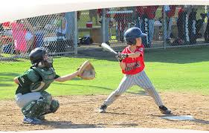
Strategic Bargaining: Ground Rules
Provides an outline of negotiation events
Determines the Union’s official time
Establishes the rules of engagement
Sets the calendar for negotiations
Determines location of negotiations
Indicates how negotiations are viewed by management
Opportunity for favorable positioning

Slide 47
Strategic Bargaining: Ground Rules
Items to consider:
Location of negotiations
Official time for negotiations
Official time for preparations
Schedule for negotiations
Size of bargaining teams
Observers
Subject Matter Experts
Cost
Administrative
Logistics

Slide 48
Strategic Bargaining: Ground Rules
Procedures to consider:
Caucuses
Impasses
Ratification prior to agency head review
Ensure reasons for disapproval at agency head review would be provided
Payment/reimbursement
Notes:
Ensure that sufficient time is give for ratification.

Slide 49
Strategic Bargaining Process Research

Slide 50
Strategic Bargaining: Research
Membership needs and priorities
Grievances, ULPs, MOUs, LSA during previous CBA
Agency team – bargaining style and experience
Agency budget and priorities
Notes:
Review past negotiations (CBA, MOUs, LSAs) with same or related parties (including other Components of DHS); identify management’s position on key issues, as well as Union gains and worthwhile language; review of recent settlements with Agency and impact on contract and issue development
Identify relevant contract language, grievances and arbitrations, past practice, and issues that have risen during life of previous contract; common goals of parties
Identify mgmt. strengths and vulnerabilities, i.e., legal, legislative & regulatory, political & community relations; key management players and their roles, authority, personality and negotiating style; mgmt. strategies at the bargaining table, in other forums (filing ULPs, etc.) communicating with employees and the public
Pre-drafted arguments to various doctrines (compelling need, management rights, permissive subjects, others?)

Slide 51
Strategic Bargaining: Research
Pre-drafted arguments to various analytical framework doctrines
AFGE resources
FLRA guidance
FSIP decisions
CyberFEDS
Notes:
Pre-drafted arguments to various doctrines (compelling need, management rights, permissive subjects, others?)

Slide 52
Strategic Bargaining: Research
Bargaining Calendar of Events
Effective date of current agreement
Window for reopening agreement specified in determination letter
Date demand to bargain sent/received
Time needed to draft proposals
Timing of workplace actions and events

Slide 53
Strategic Bargaining Process Proposal Development

Slide 54
Step One – Bargaining Survey
Draft Bargaining Survey
Distribute Bargaining Survey
Collect Bargaining Survey
Review Bargaining Survey to Identify:
Common issues that appear often
Novel issues that appear infrequently but are worthy of note
Bargaining issues versus concerns/suggestions
Issues to be addressed through representation
Compare results to initial goals – do goals need to be expanded?
Notes:
Determine what are actual bargaining Issues as opposed to concerns or suggestions that cannot be bargained.

Slide 55
Step Two – Research
Research proposals based on:
Bargaining goals
Membership survey results
Leadership knowledge and experience
Prior grievances, MOAs, and disputes
Changes in federal workplace standards
Contract language/guidance from similar contracts, Bargaining for the Future

Slide 56
Step Three – Strategize
The bargaining team should talk, before furnishing the agency with any contract proposals, to identify:
Aspirational and bottom line positions on each Article up for negotiation
Strategy regarding Article in regards to:
Communications and mobilization
Plan for moving from starting position to final position
Common goals and needs of both parties
Areas of potential compromise and tradeoffs

Slide 57
Step Four – Draft
Proposal language should be drafted and reviewed by the full team after:
Research has been done
Needs assessed
Goals identified
Aspirational and bottom line positions discussed, and
Bargaining strategies established

Slide 58
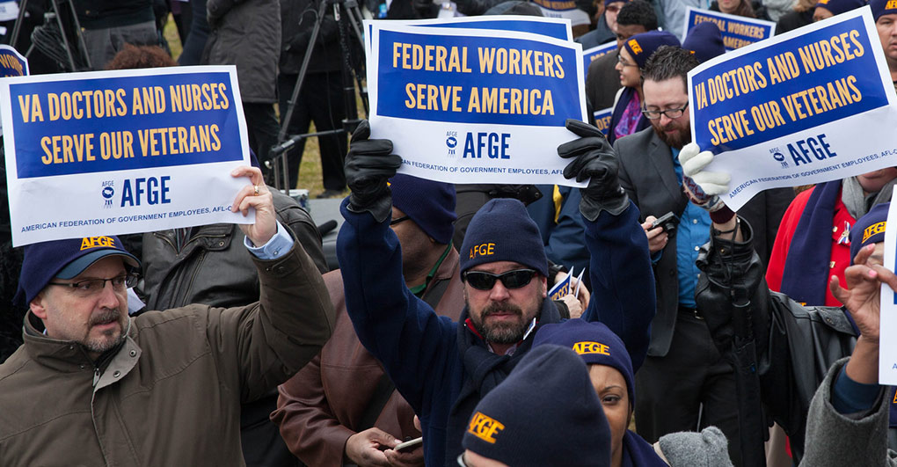
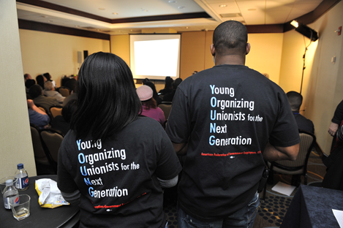
Strategic Bargaining Process Communicate, Mobilize and Organize

Slide 59
Communicate – No Blackouts!
Never agree to Agency’s request to eliminate or limit your ability to communicate with your members during bargaining!

Slide 60
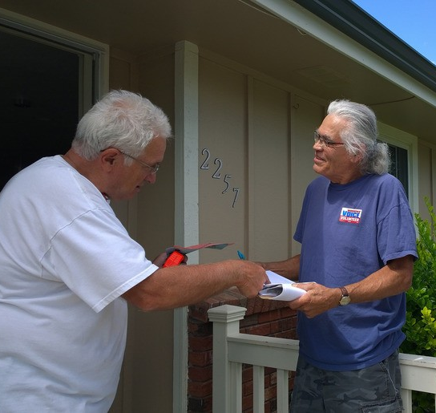
Communicate with Employees
COMMUNICATE WITH EMPLOYEES
PRE-NEGOTIATION – Survey/Meetings
DURING NEGOTIATIONS – Inform and Action
POST NEGOTIATION – Ratification
How do we communicate with employees now?
Is it working?
Is there something we need to include in the CBA?

Slide 61
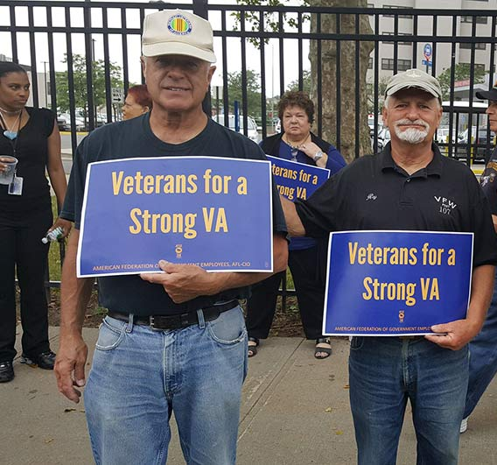
Communication: Outreach
Members
Employees
Other Unions
Community Groups

Slide 62
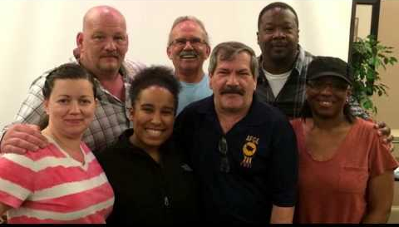
Benefits of Mobilization
Leverage at the table
Builds investment in the contract
The bargaining unit will have more input and know that they have a voice
The bargaining unit will feel ownership of the process
Notes:
Leverage at the table- it is easier to justify a demand when the bargaining unit is vocal
The bargaining unit will have ownership of the process- they will have more input, and know that they have a voice
The bargaining unit will feel ownership of the process- when bargaining is over, they will have been in the trenches for the fight, and understand what the bargaining team could and could not get at the table.

Slide 63
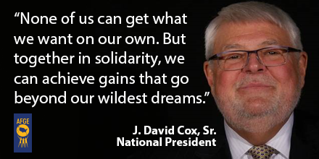
Mobilize: Members Own the Contract
Contract will be easier to ratify because the BU fought to make it happen.
Changes how employees view the process and their rights.
BU will see the relationship between activism, gains at the table, and rights at work.
Workplace action builds power at the table, but is also an organizing tool.
Notes:
The bargaining unit will have ownership of the contract- the contract will be easier to ratify because the BU fought to make it happen.
The bargaining unit will feel ownership of the contract - changes how the BU is oriented towards the process and the rights they get, and will understand the relationship between activism, gains at the table, and rights at work.
Workplace action builds power at the table, but also as an organizing tool.

Slide 64
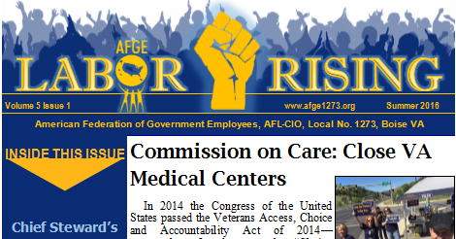
Mobilize: Workplace Actions
Coordination with other nearby/related AFGE Councils and locals for potential support
Messaging to explain goals, needs and struggles
Informational picketing
Button wearing
Petitions
Letter writing campaign

Slide 65
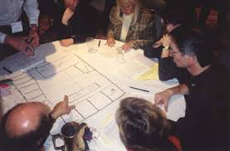
Mobilize: Workplace Actions
Make the union and negotiations visible in the workplace
Practice and share SSMS (“stupid stuff management says”)
Use Council/Local mapping to identify
Where specific issues of importance are to employees
Where you need to organize around negotiations
Who you can depend on to mobilize workplace actions
Notes:
Make the union and negotiations visible in the workplace
PRACTICE and SHARE SSMS (“stupid stuff management says”)
Use Council/Local MAPPING to identify WORKPLACE ACTIONS
Where you can depend on workplace actions
Where you need to organize around negotiations
Where specific issues are of importance to employees

Slide 66
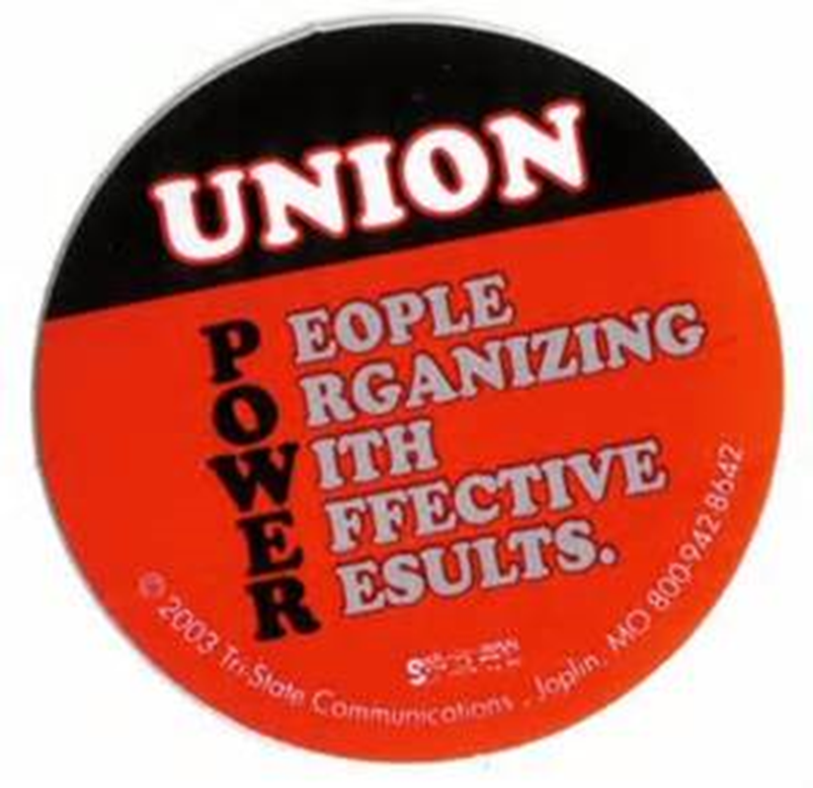
Mobilize = POWER

Slide 67
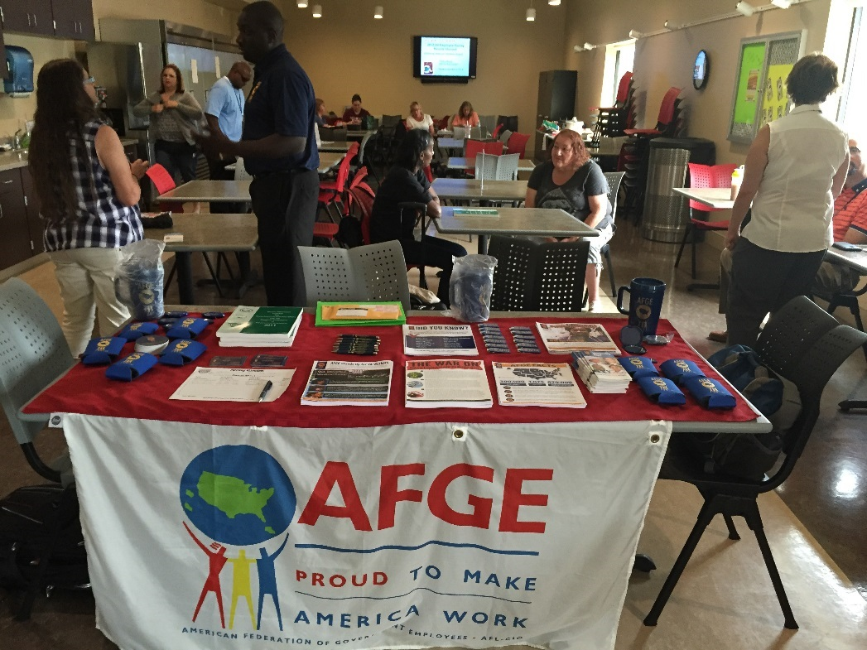
Organize: Workplace Actions
Establish Organizing goals
Identify and recruit workplace leaders
Make sure the organizing message:
relates to negotiations
links directly to membership concerns
Create organizing calendar with events

Slide 68
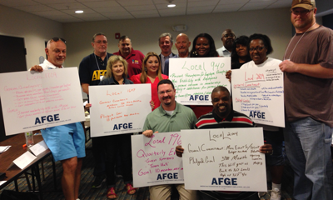
Organize: Workplace Actions
Collect and maintain up-to-date contact information for the bargaining unit
Target employees who have shown an interest in how negotiations are going
Deliver newsletter, bargaining updates
Maintain and work phone trees for updates, events, and actions

Slide 69
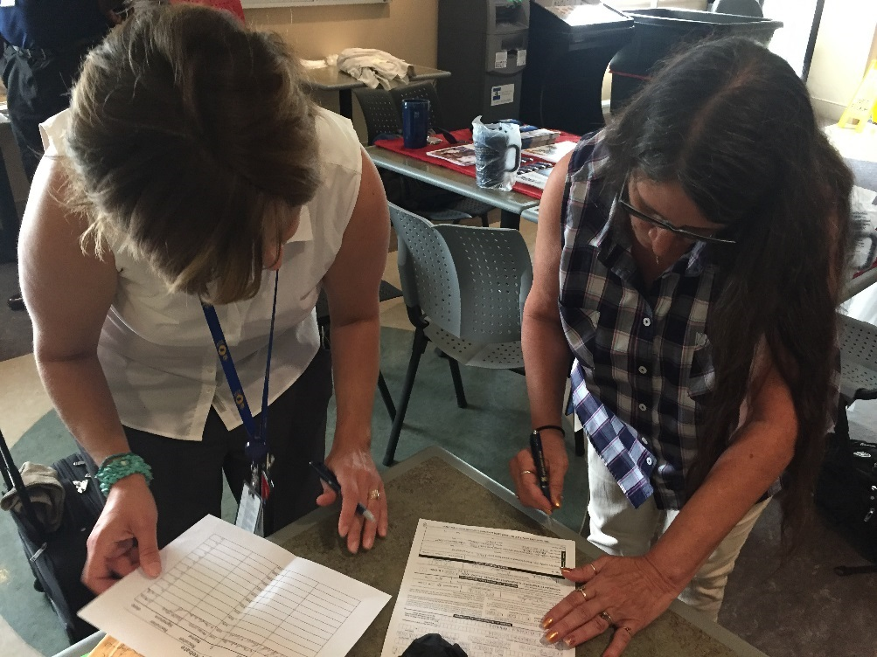
Organize: Deliver a Message
800 person bargaining unit with 100 members, outdated contract, no changes favorable to employees in years
Union demands to bargain and solicits for employee input
Host organizing events and adds 400 members
What’s the message to management?

Slide 70
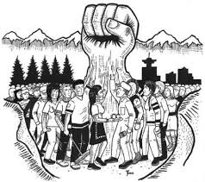
Organize: Deliver a Message
Organizing occurs during negotiations
Workplace visibility of the union increases
New members added on a regular basis
Membership level grows past 50%
Union power at the bargaining table increases

Slide 71
Strategic Bargaining Plan Development
AMERICAN FEDERATION OF GOVERNMENT EMPLOYEES, AFL-CIO

Slide 72
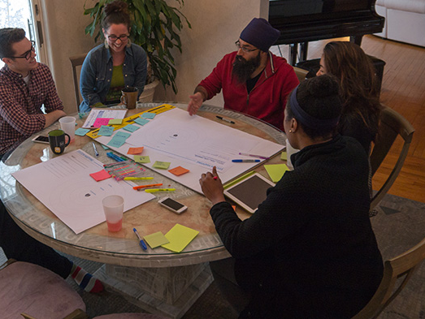
Plan Development
Goal
Action(s)
Link To Bargaining Process
Resources
Research
Admin Support
Organizing
Communication/Outreach
Workplace Actions
Budget

Slide 73
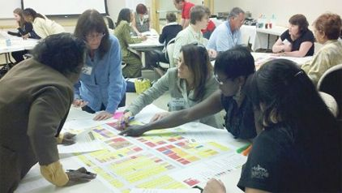
Plan Development: Add Detail
WHO – responsible party, group, committee
WHAT – specific action
WHERE – location
WHEN – dates, time frame, calendar
WHY – link to objective
HOW – resources, budget

Slide 74
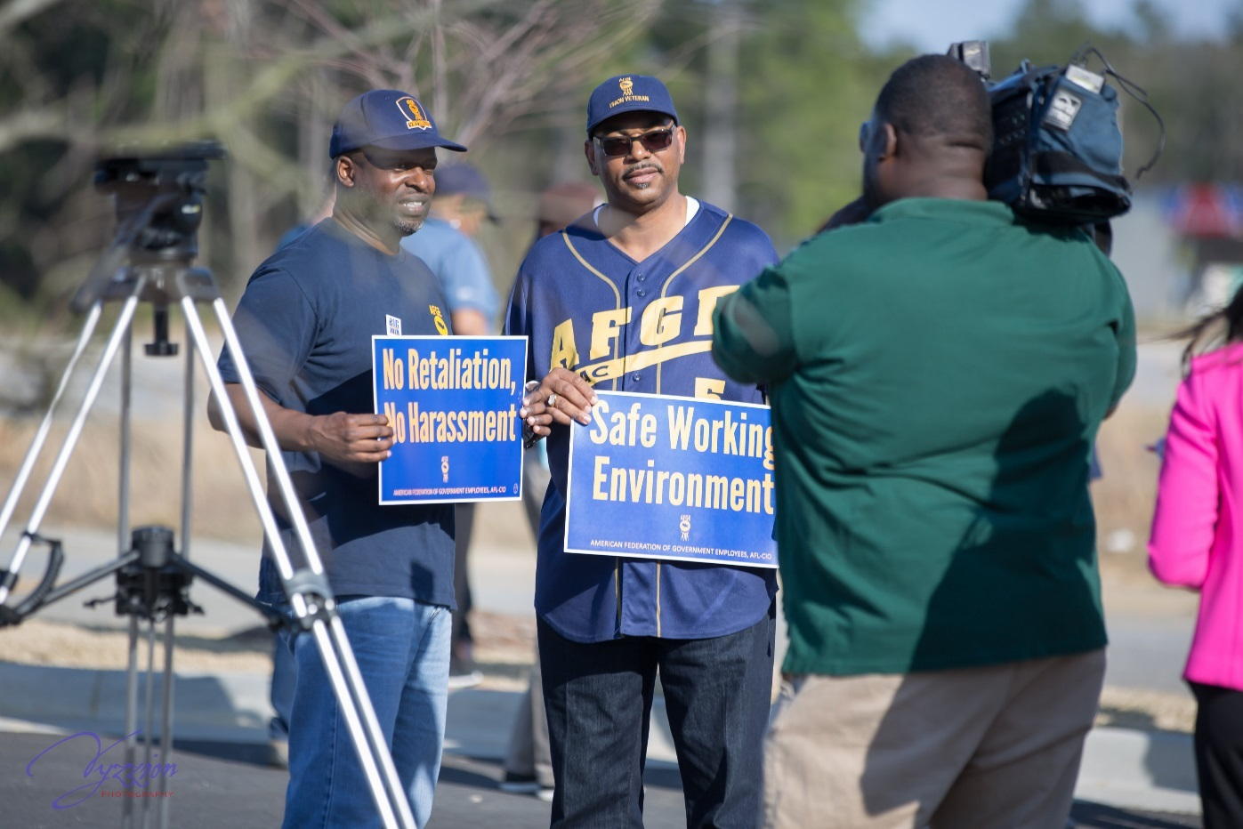
TURN PROCESS INTO STRATEGY
TRAIN
PREPARE
PLAN

